Slide 1



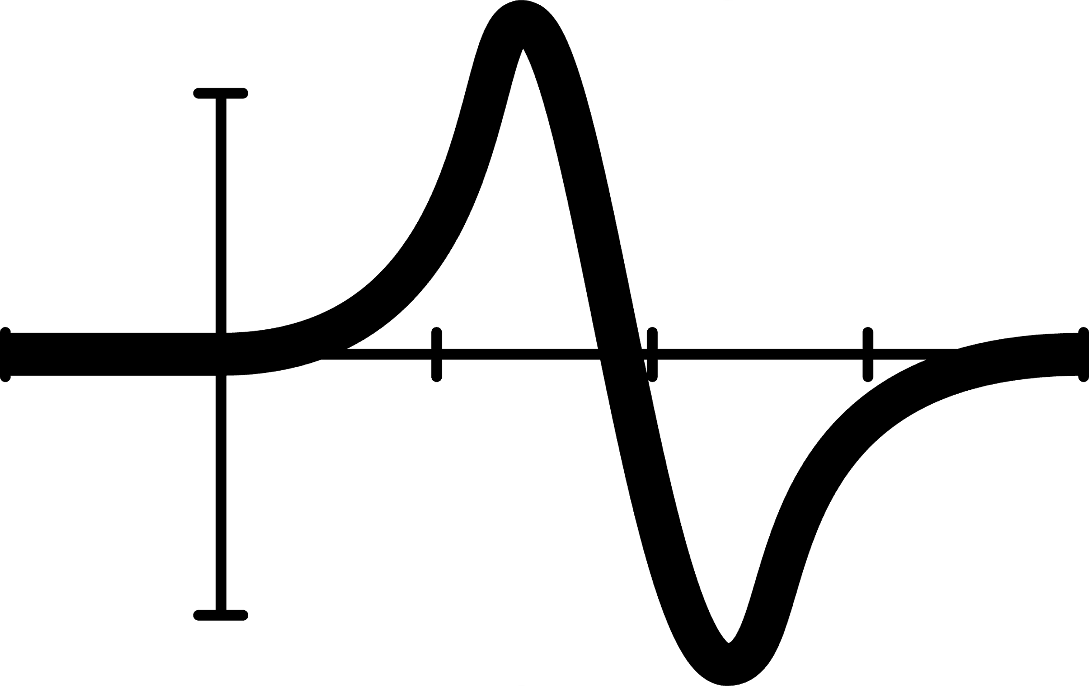


Online News Popularity
Yifan Xia 1005937934
Boxuan Fang 1006013984
Varun Datta 1006693464
Emin Rza 1006991560

Slide 2



Introduction
“What key factors contribute to the virality of Mashable article in social media, as measured by share count and how can we interpret this relationship in a quantifiable manner?”
Motivation:
identify and measure the influence of various elements, including content characteristics, timing of publication, and user engagement

Slide 3
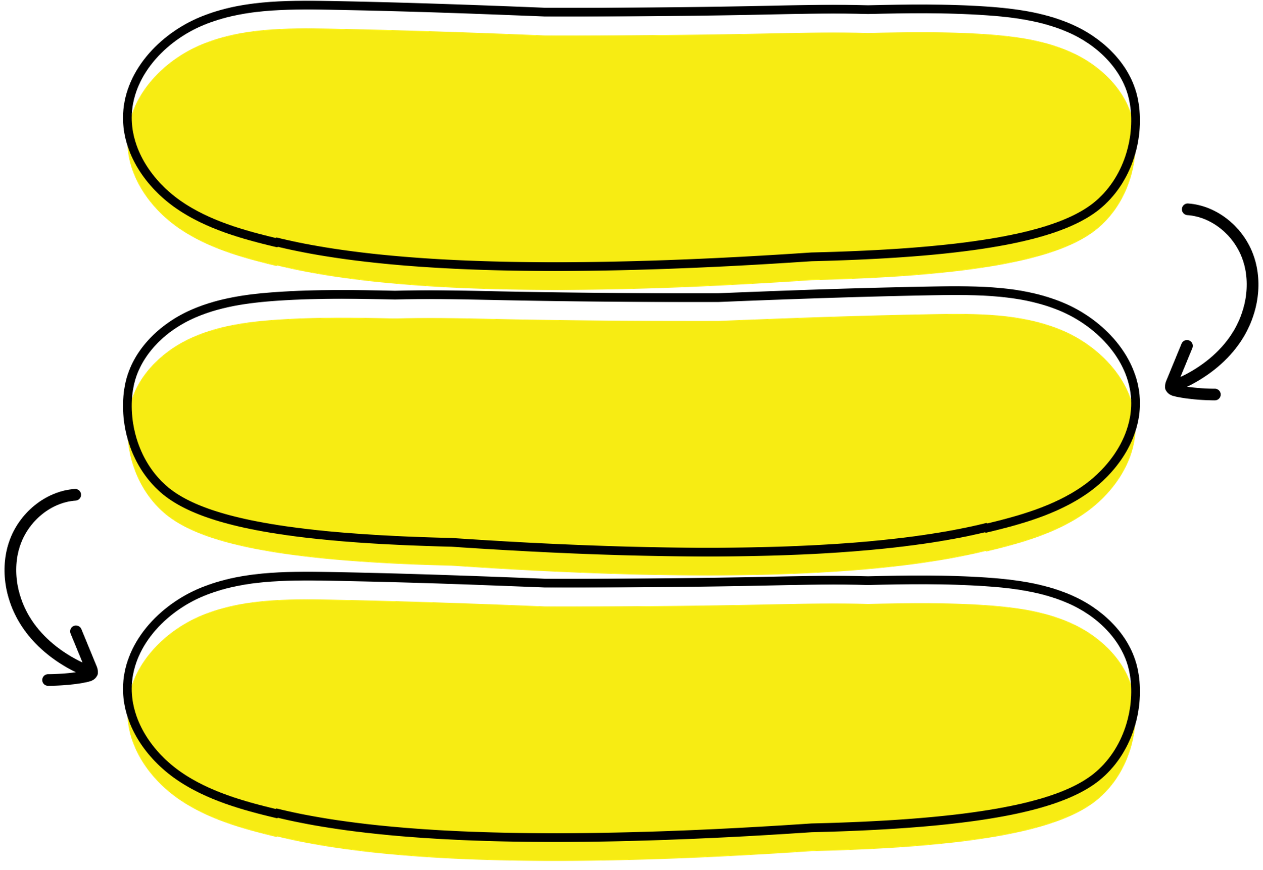
Procedure
Step 1:
Exploratory Data Analysis (EDA), Data Cleaning, and Checking for Collinearity
Step 2:
Stepwise Selection and all Possible Subset Regression
Step 3:
Development of an Interaction Model
Step 4:
Refinement of Interaction Model
Step 5:
Model Diagnostics
Step 6:
Final Model Development
Step 7:
Model Validation

Slide 4

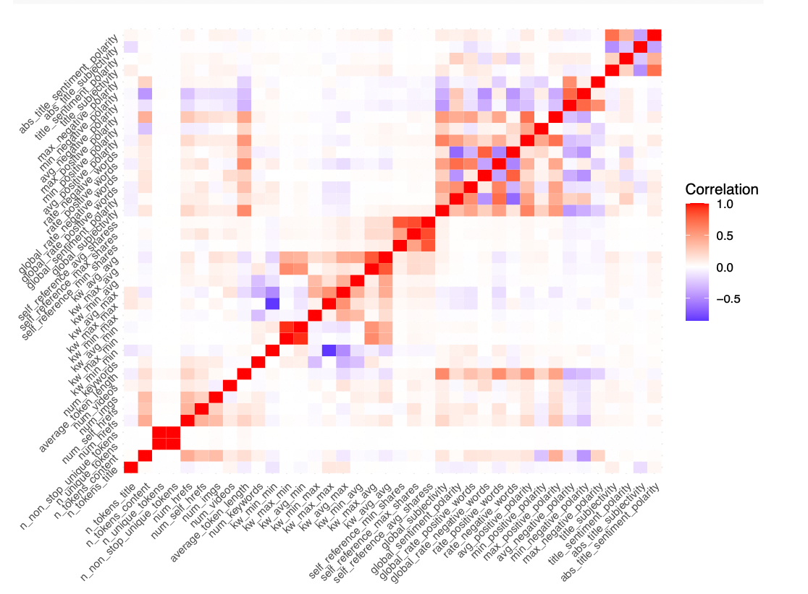

Analyzing dataset
checking for duplicates and missing values
eliminating instances of multicollinearity by removing highly correlated variables

Slide 5





Analyzing dataset
This refinement was guided by both statistical rationale and logical deduction, considering the direct relevance of each variable to the predictability of shares.
The upcoming analysis will deploy regression techniques。

Slide 6
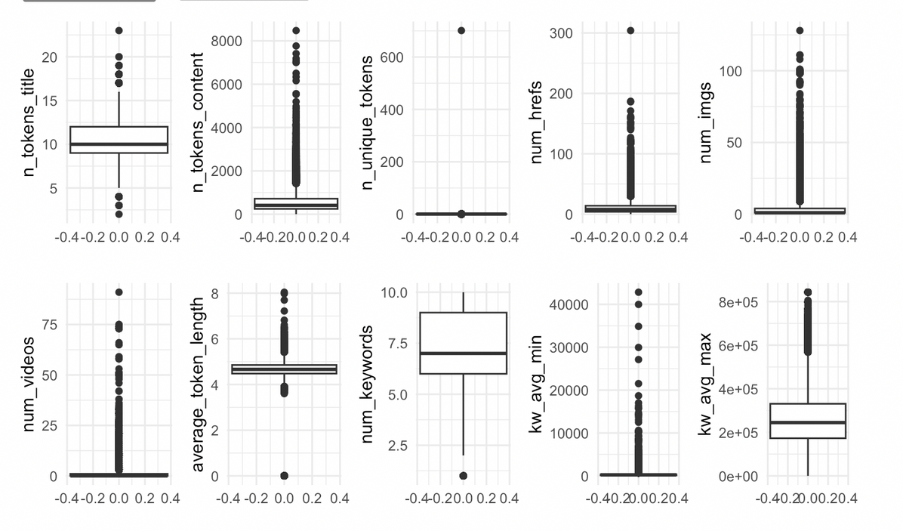
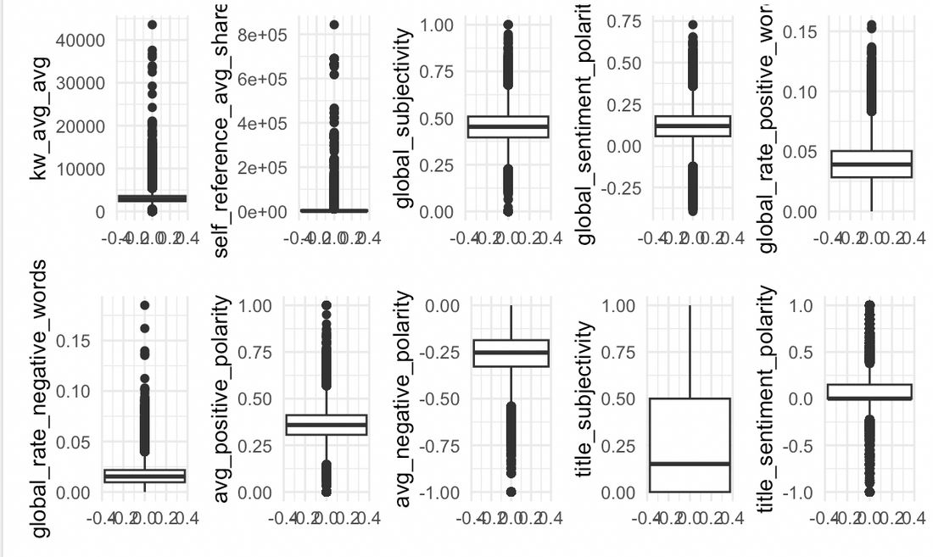


Description of dataset
eliminated the outlier by removing the corresponding data point

Slide 7

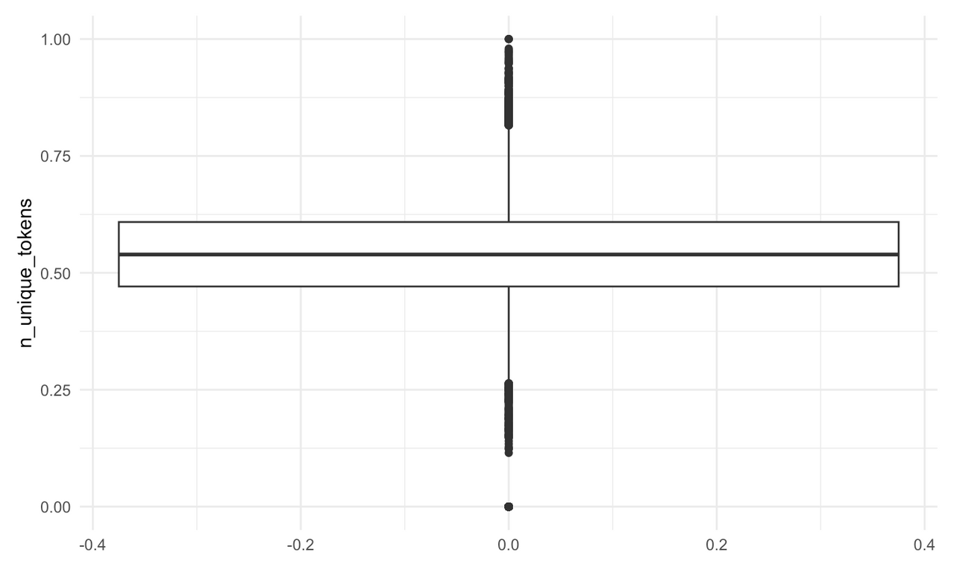
Description of dataset
After dropping the outlier, this is how our new boxplot looks like.

Slide 8
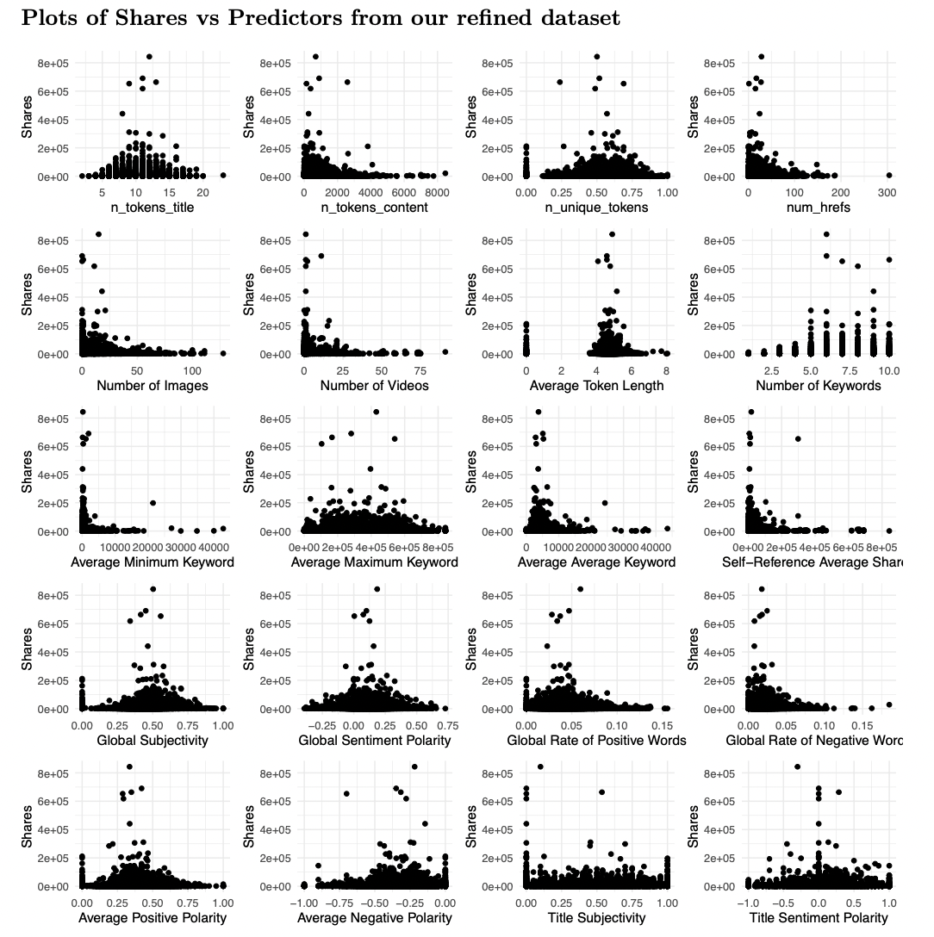
Description of dataset

Slide 9

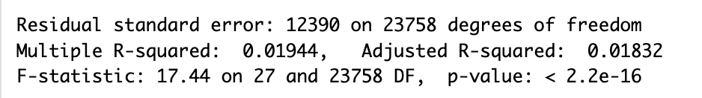


Model Building
From this model:
adjusted R-squared: 0.01832
Let’s try dropping some insignignifant predictors using F-test.
Use step-wise selection to see which combination of predictors will give us the lowest AIC

Slide 10
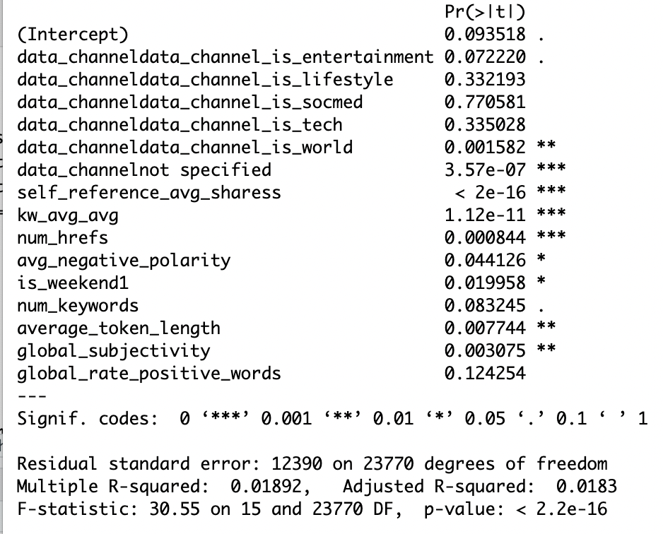

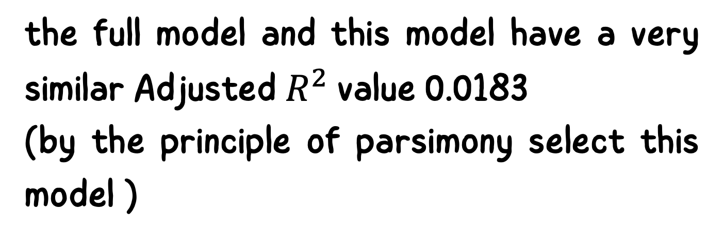
Model Building
the full model and this model have a very similar Adjusted $R^{2}$value 0.0183
(by the principle of parsimony select this model )
the’num_keywords'and’global_rate_positive_words' variables are not significant
(compare a reduced model against the full model using an F-test)

Slide 11

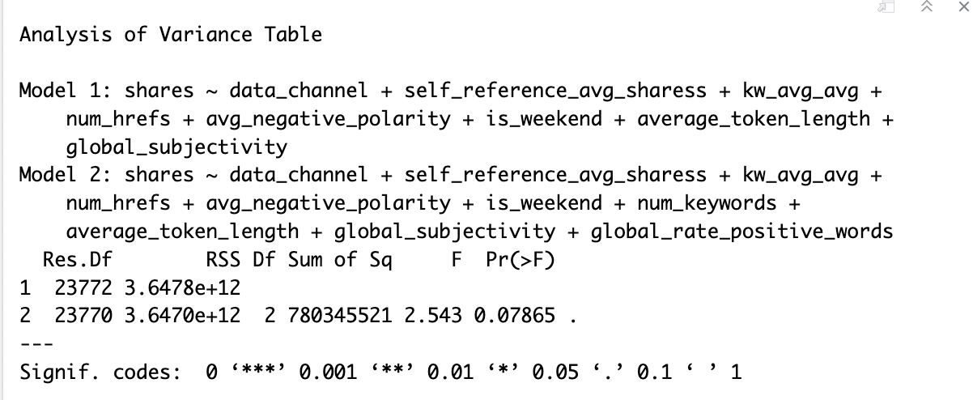
Model Building - Main Effect
We fail to reject Ho at a 95% significant level. Thus, we drop ‘num_keywords'and ’global_rate_positive_word’
After dropping the two variables, we have our final main effect model.

Slide 12
Model Building - cont.
Now, let's consider a model with interactions, where we have all the interactions between all the explanatory variables. Then, we will use step-wise selection to get the model with the lowest AIC to check if we have any improvements resulting by adding interaction terms.

Slide 13


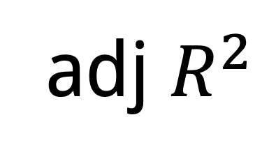
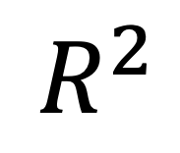
Model Building –
Interaction Model
AIC
-620.53
In comparison with our main effect model, our final interaction model has lower AIC and BIC values, whereas values for R_squared and Adj_R_squared increased.
BIC
-467.07
$$R^{2}$$
0.0268
adj $R^{2}$
0.0260

Slide 14

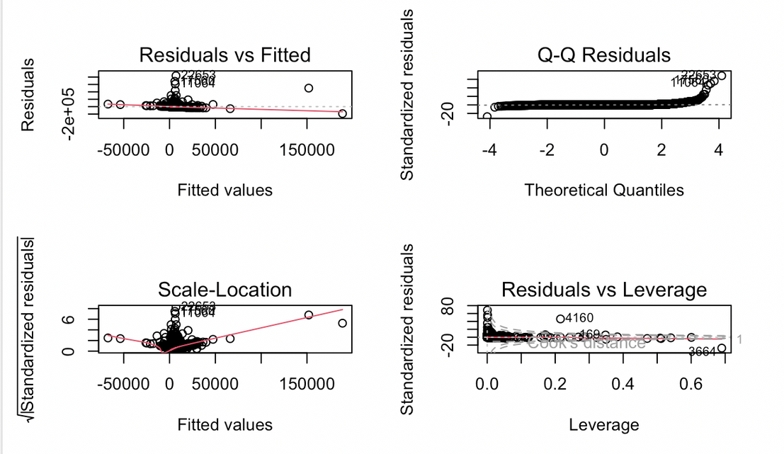

Model Diagnostics
The assumption of equal variance appears to be violated. Further scrutiny of the Q-Q residual plot leads to the inference that the normality assumption is also likely violated.

Slide 15
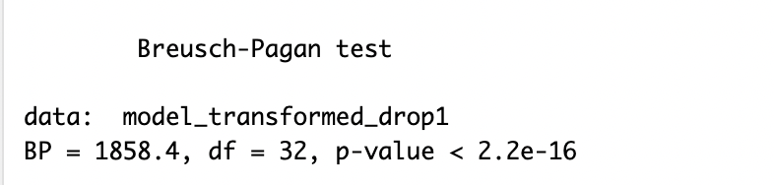

Model Diagnostics
Under 95% confidence level, we have substantial evidence to reject the Ho, meaning that heteroscedasticity is still present in the regression model.
To keep improving our constant variance assumption, we will use the weighted least square approach to see if the assumption and the model can be overall improved.

Slide 16
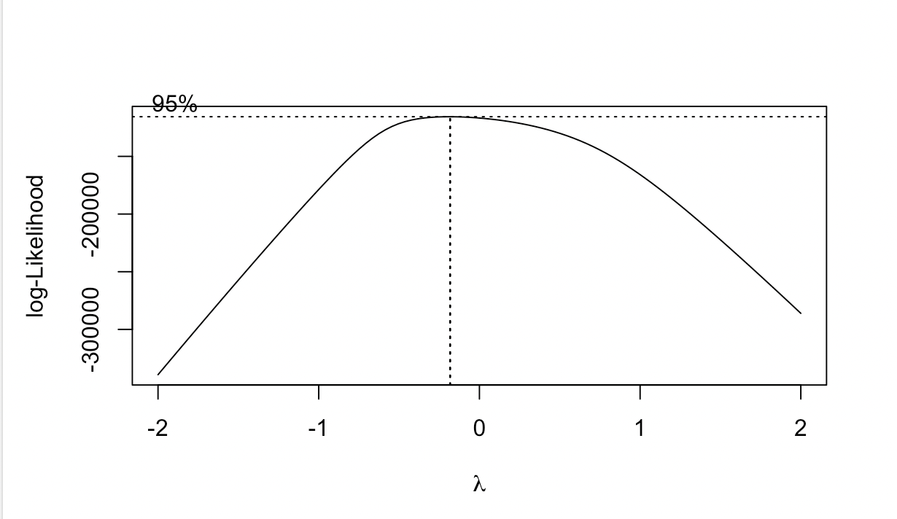
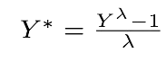
Remedial Method
With λ = -0.18, we will implement the box-cox transformation.

Slide 17
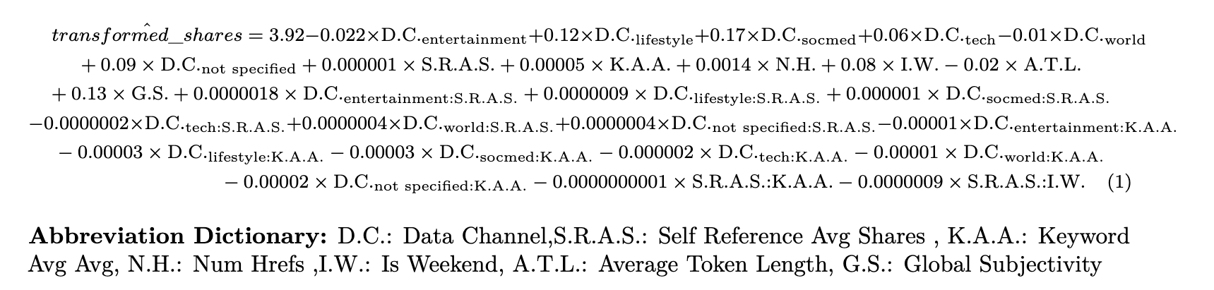
Applying WLS
After we did Box-Cox Transformation and WLS method, we also used Reduced model Full model F test to drop some insignificant variables.

Slide 18
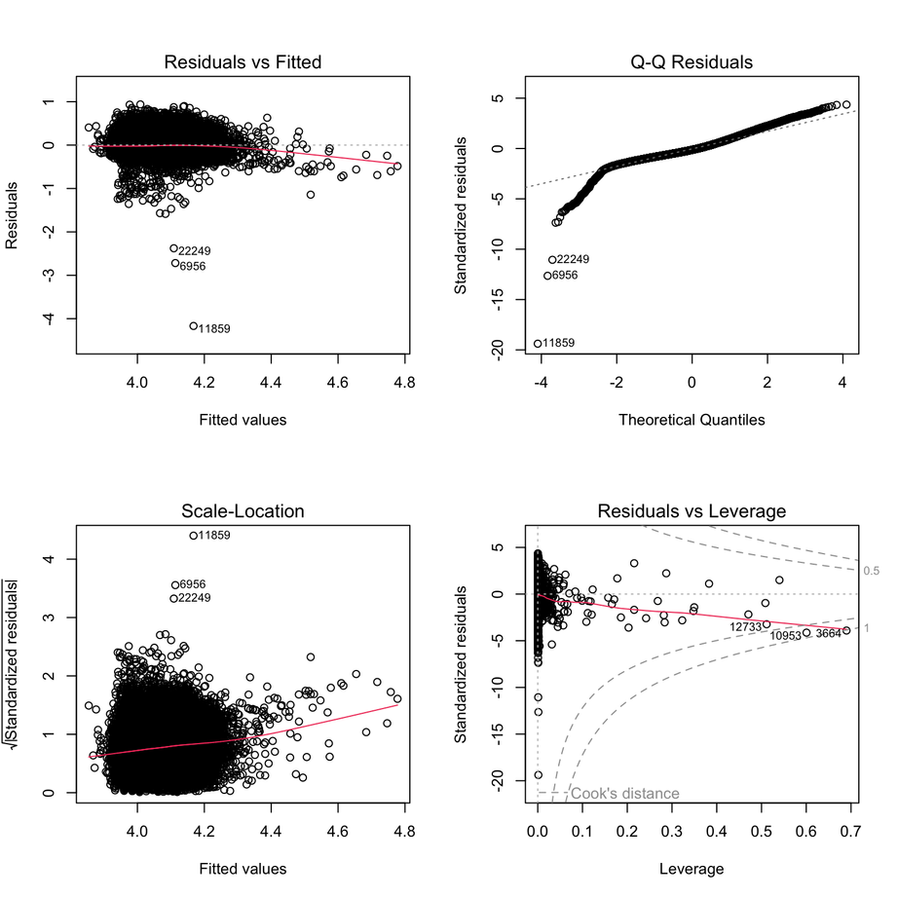
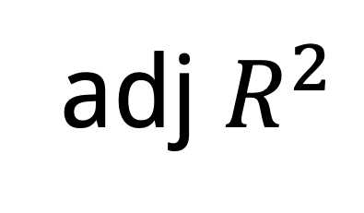
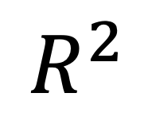
Model Diagnostics
AIC
-521605.05
BIC
-521500.06
$$R^{2}$$
0.09699790
adj $R^{2}$
0.09656682
Comparing with the main effect model

Slide 19
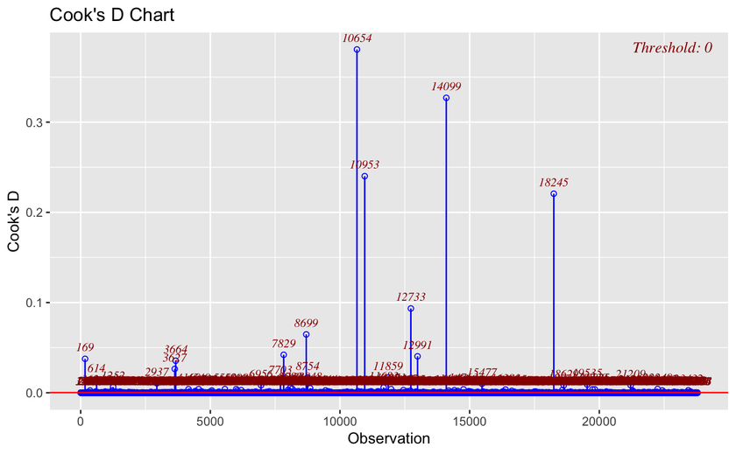
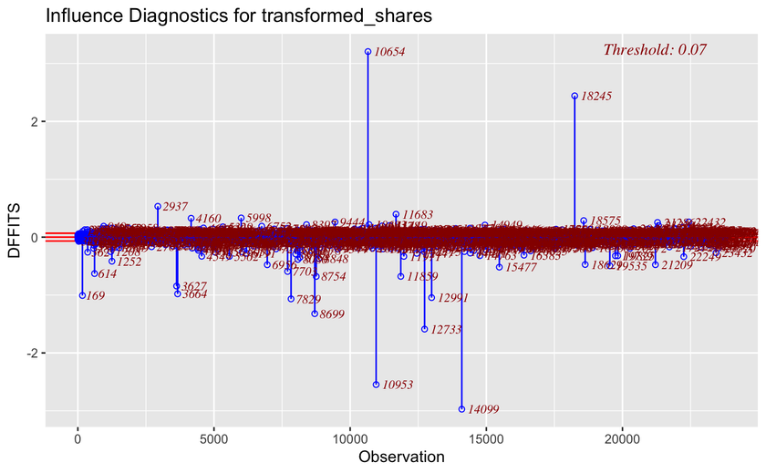
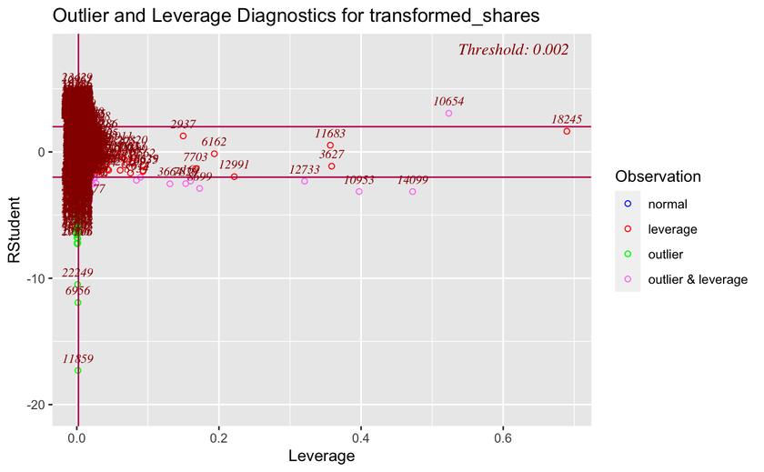
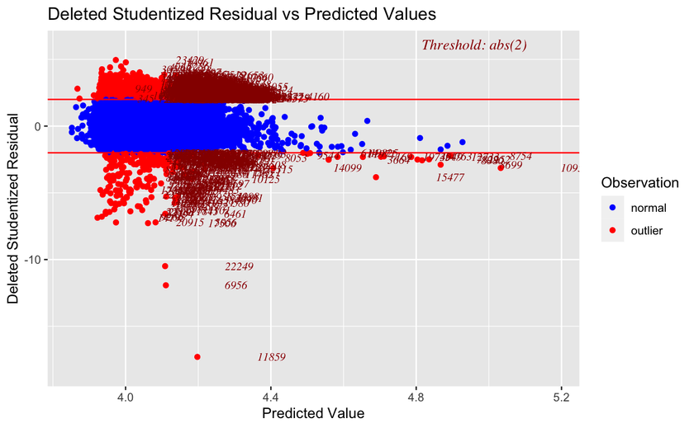
Model Diagnostics

Slide 20

Model Validation
MSE = 0.08
cross-validation : MSPE = 0.04
K-fold cross-validation : Avg RMSE = 0.05

Slide 21
Thank You

